Slide 1
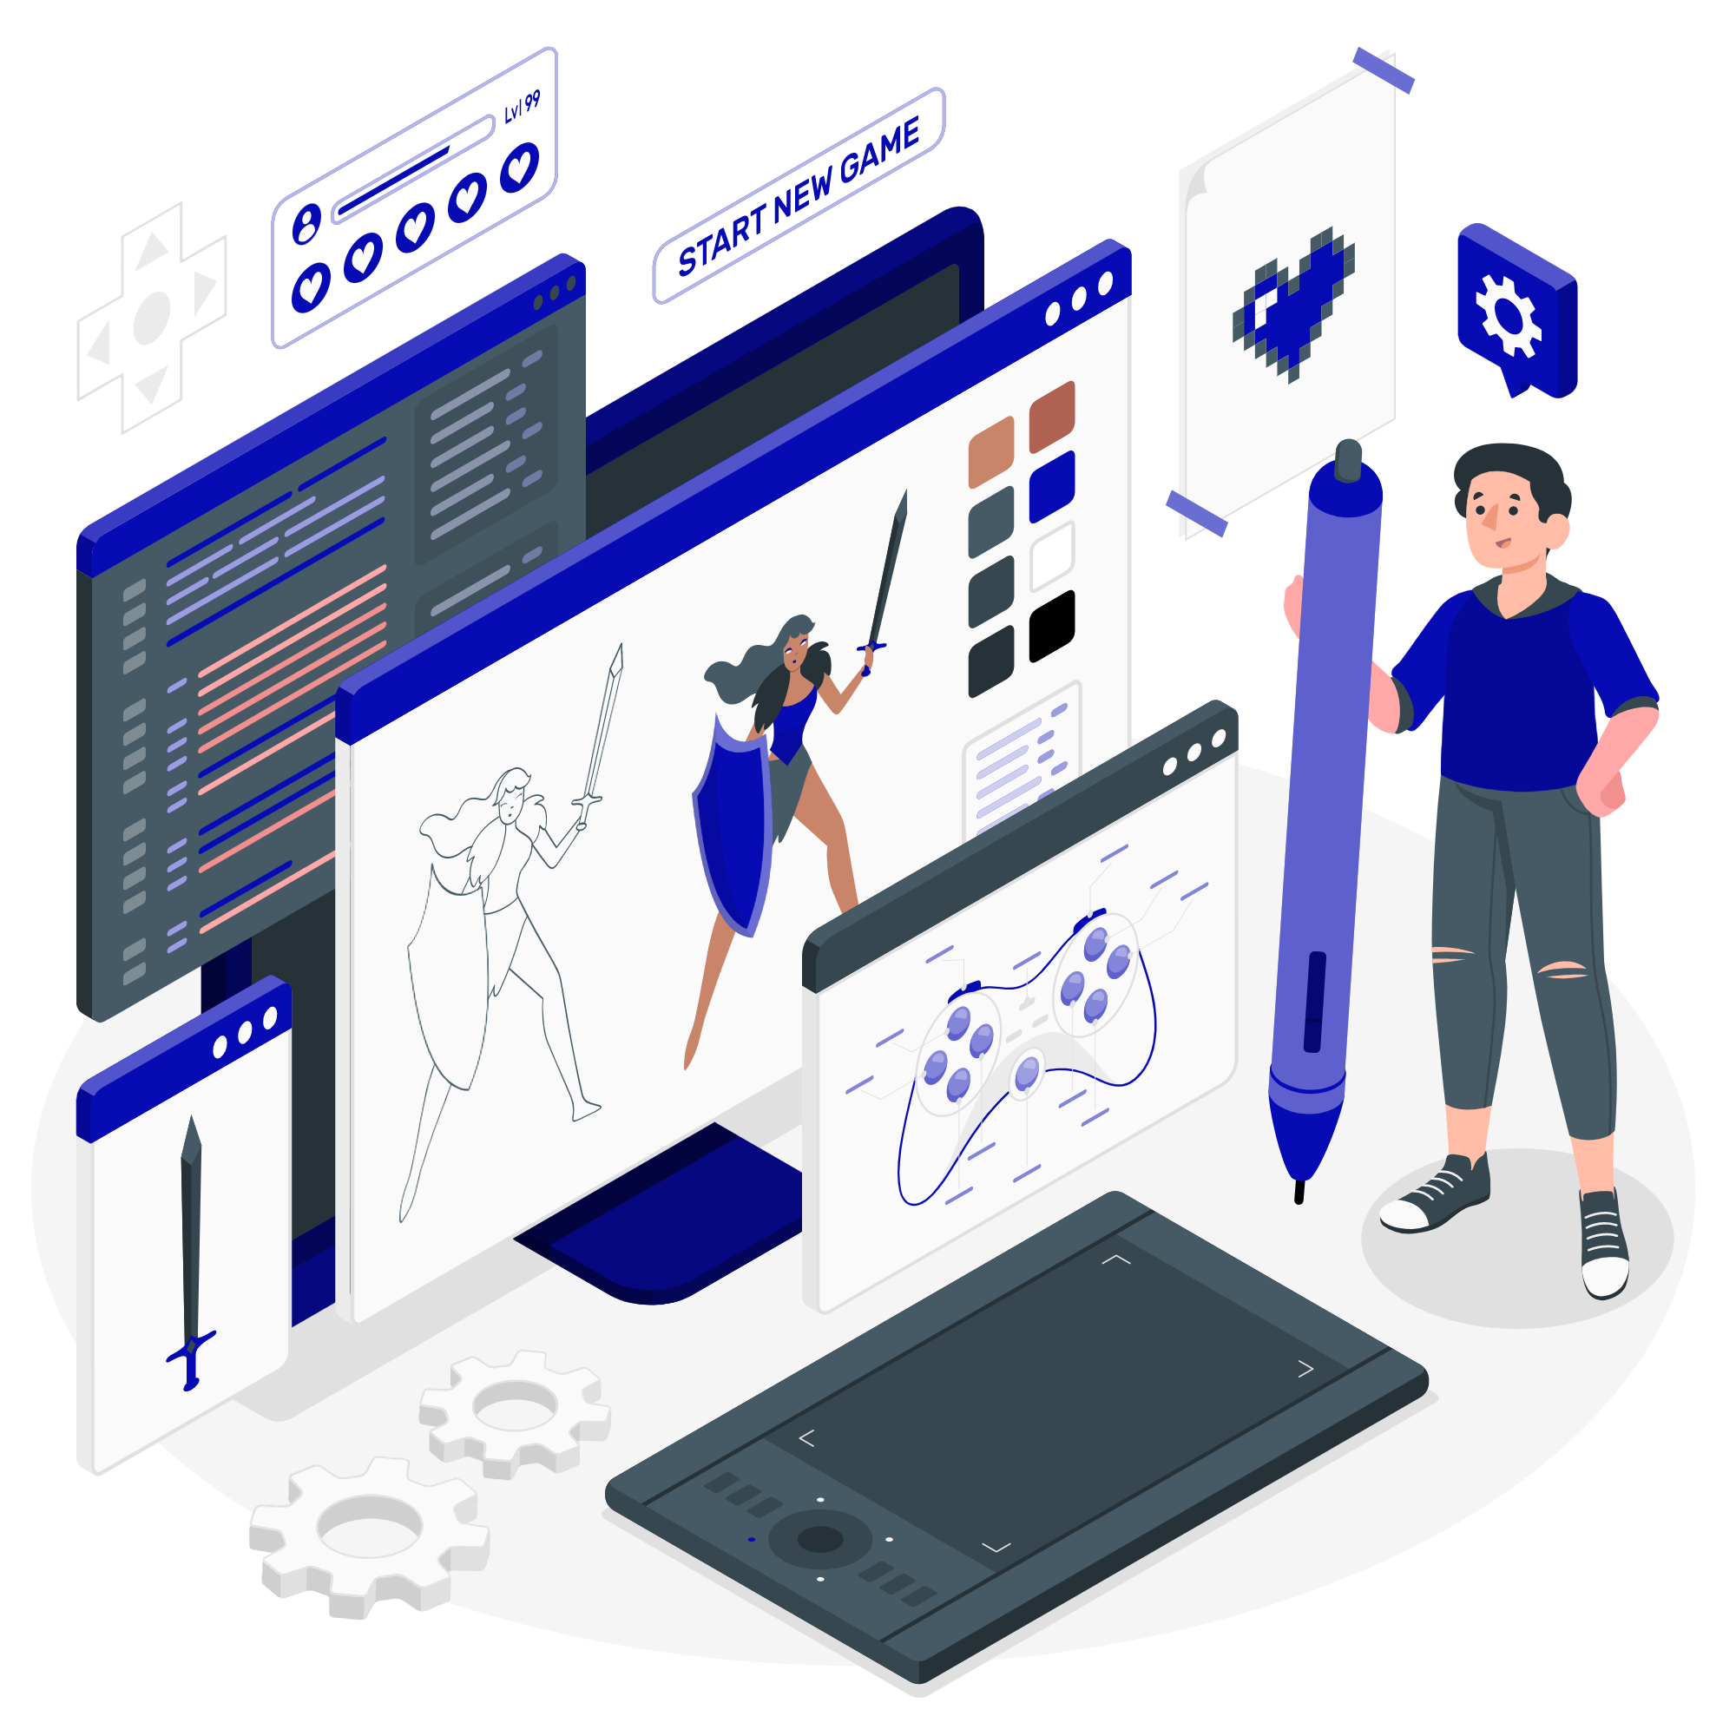
MEMBRANCE
CS3247 GAME CONCEPT
Team 11
Alex, Thang, Jason, Tian Fang, Zhu Bo, Edeline
Notes:
Zhu Bo

Slide 2
TABLE OF CONTENTS
01
Introduction
02
High-Level Description
03
Lens
04
Selling Points
Title, Genre and Platform of the game.
Story, Goal, Main Characters
Mechanics of the game.
Sold.
Notes:
Zhu Bo

Slide 3
01
Introduction
Notes:
Zhu Bo

Slide 4
TITLE
GENRE
PLATFORM
Membrance
PC
Action Platformer
Notes:
Zhu Bo

Slide 5
02
High-Level Description
Notes:
Alex

Slide 6
High Level Description
STORY
The World has begun to completely unravel…
The Demon King has stolen your memories!
Fight his army to take them back!
But as you retrieve them….
The levels look corrupted/overlaid with different things not from this world/ our reality
Defeating the Demon King should solve everything, right?
Notes:
Alex

Slide 7
High Level Description
GOAL
Defeating the boss, freeing the “world”
Successfully reach the end destination each level, by traversing the world
CHARACTERS
Protagonist & Enemies
E.g. Bullies/Enemies/People you don't get along with
Notes:
Alex

Slide 8
Flow
1
The player starts at the beginning of the level.
2
Upon encounter with enemies that are spread throughout the level, the player will attack using combat techniques.
3
The player will sometimes find blocked paths, and will have to figure out the mechanism to unlock it.
4
The player collects items (e.g. shards of memories, food to recover health, coins, etc) along the way if found.
5
Upon reaching the end destination successfully, player will learn more of the story progression and can move on to the next level.
Notes:
Edeline

Slide 9
Primary Actions
MOVEMENT
BATTLE
ABILITIES
Run
Dash
Jump
Float/Glide
Swim
Climb
Slashing (Melee)
Use objects & elements from surroundings to defeat enemies
Absorbing (e.g. weapon enchantment)
Time-freeze/Slow Motion
Changing skills through pets
Notes:
Edeline

Slide 10
03
Lens
Notes:
jason

Slide 11
LENs
Mechanics
LENS 7
Elemental Tetrad
Exploring
Move freely around the terrain using the primary actions
Interact with objects (e.g. carry and throw) to help with navigating terrain or fighting.
Combat
Basic weapon attacks
Able to absorb skills from defeated enemies
For each battle, the player is able to choose 3 skills to use
Notes:
jason

Slide 12
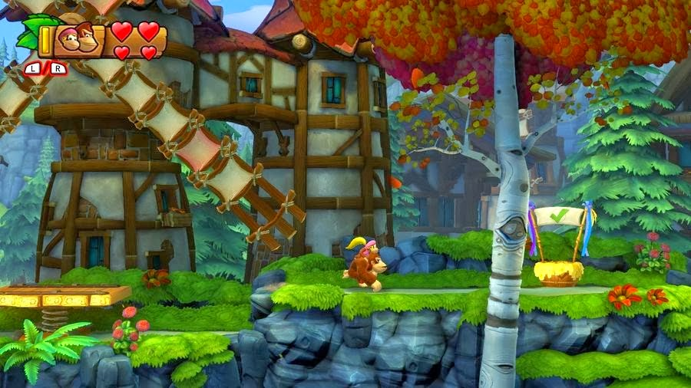
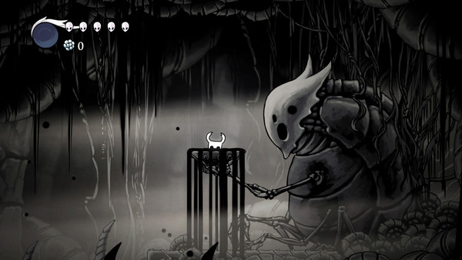
LENs
Aesthetic
LENS 7
Elemental Tetrad
Level aesthetic covers both ends of the spectrum
Includes very vibrant (kirby, donkey kong)
Progressively growing darker (but not strictly) to fit our story with some tension release in between
Includes very gloomy
Notes:
jason

Slide 13
LENs
Technology
Story
LENS 7
Elemental Tetrad
Windows 10 Support
Not the first PC 2D platformer, but we will try our best for a bug-free; lag-free experience
Linear storyline
Building up conflict as story progresses
Resolution to the conflict at the end
Notes:
jason

Slide 14
LENs
LENS 39
Meaningful Choices
Cost:
Currency: Sanity points/gems
Weapon-specific (e.g. Reduce health)
Voluntary sanity loss:
Tougher level but better reward
Story specific (e.g. use memory shard and lose it)
Triangularity
LENS 40
Reward:
Special weapons/enchantment
Collectables
Abilities (power up, rage mode etc)
Notes:
Tian Fang

Slide 15
LENs
LENS 6
Problem Solving
The Puzzle
LENS 58
More than one way to defeat enemies
Technique/skills v.s. Strategy, or both; it’s up to the player to decide
Variety of Interesting puzzles
Notes:
Tian Fang

Slide 16
LENs
LENS 91
Character Transformation
Idea 1;
The character gains back precious memories (both good and bad) as the player is completing the game
The character cherishes good memories more and learns to appreciate bad memories
Idea 2
As the character confronts the various levels and bosses, the character witnesses elements and memories that do not correspond to the world
He begins to question aloud his own sense of self, and whether he is sane
Degrading mental state reflected in levels
Notes:
Alex

Slide 17
04
Selling Points
Notes:
Ale

Slide 18
Interesting Storyline
Unique Combat Abilities
Gaining some and losing some
Absorption of enemies’ skills
Brute force v.s. Strategy
Notes:
Alex

Slide 19
THANKS!
Please keep this slide for attribution
Notes:
Alex

Slide 20
Unique Points
We won’t dream to be better than Super Mario Bros, sonic, celeste, hollow knight, castlevania, donkey kong, megaman, metroid, shovel knight,.....
Our story allows for much more dynamic designs of levels (maps can vary from a theme park to a space ship who knows :D)

Slide 21
HOME
EXPERIENCE
EDUCATION
SKILLS
HOBBIES
NAME
Here’s what you’ll find in this Slidesgo template:
A slide structure based on a CV presentation, which you can easily adapt to your needs. For more info on how to edit the template, please visit Slidesgo School or read our FAQs.
An assortment of graphic resources that are suitable for use in the presentation can be found in the alternative resources slide.
A thanks slide, which you must keep so that proper credits for our design are given.
A resources slide, where you’ll find links to all the elements used in the template.
Instructions for use.
Final slides with:
The fonts and colors used in the template.
A selection of illustrations. You can also customize and animate them as you wish with the online editor. Visit Storyset to find more.
More infographic resources, whose size and color can be edited.
Sets of customizable icons of the following themes: general, business, avatar, creative process, education, help & support, medical, nature, performing arts, SEO & marketing, and teamwork.
You can delete this slide when you’re done editing the presentation.

Slide 22
HOME
EXPERIENCE
EDUCATION
SKILLS
HOBBIES
01
EXPERIENCE
You can enter a subtitle here if you need it

Slide 23
INSTITUTION 1
(NAME Of the GAME)
Genre:
Platform:

Slide 24
HOME
EXPERIENCE
EDUCATION
SKILLS
HOBBIES
EXPERIENCE
2010-2012
01
Jupiter is a gas giant and the biggest planet of them all
02
2012-2016
Mercury is the closest planet to the Sun and the smallest of them all
2016-2017
03
Despite being red, Mars is actually a cold place. It’s full of iron oxide dust
04
2018-2020
Earth is the beautiful planet where we all live. It’s full of life!

Slide 25
HOME
EXPERIENCE
EDUCATION
SKILLS
HOBBIES
SOFTWARE SKILLS
NAME
SOFTWARE 1
SOFTWARE 2
SOFTWARE 3
Mercury is the closest planet to the Sun and the smallest one
Venus has a beautiful name and is the second planet from the Sun
Despite being red, Mars is actually a cold place. It’s full of iron oxide dust

Slide 26
HOME
EXPERIENCE
EDUCATION
SKILLS
HOBBIES
NAME
AWESOME WORDS

Slide 27
HOME
EXPERIENCE
EDUCATION
SKILLS
HOBBIES
JOB POSITION 1
NAME
2010-2012
COMPANY NAME
Position here
List your responsibilities for this job
Adapt this to your needs
Try to keep it short
Get straight to the point
Don’t omit important information

Slide 28
HOME
EXPERIENCE
EDUCATION
SKILLS
HOBBIES
VOLUNTEER WORK
NAME
MARS
Despite being red, Mars is a cold place
VENUS
Venus is the second planet from the Sun
JUPITER
It’s the biggest planet in the Solar System

Slide 29
HOME
EXPERIENCE
EDUCATION
SKILLS
HOBBIES
EDUCATION
NAME
2006
2008
2010
MERCURY
VENUS
MARS
It’s the closest planet to the Sun and the smallest in the Solar System
Venus has a beautiful name and is the second planet from the Sun
Despite being red, Mars is actually a cold place. It’s full of iron oxide dust

Slide 30
HOME
EXPERIENCE
EDUCATION
SKILLS
HOBBIES
NAME
55,000
Big numbers catch your audience’s attention

Slide 31

HOME
EXPERIENCE
EDUCATION
SKILLS
HOBBIES
NAME
A PICTURE IS WORTH A THOUSAND WORDS

Slide 32
HOME
EXPERIENCE
EDUCATION
SKILLS
HOBBIES
NAME
—SOMEONE FAMOUS
“This is a quote, words full of wisdom that someone important said and can make the reader get inspired.”

Slide 33

HOME
EXPERIENCE
EDUCATION
SKILLS
HOBBIES
THIS IS A GRAPH
NAME
38%
24%
MARS
JUPITER
Despite being red, Mars is a cold place
It’s the biggest planet in the Solar System
12%
36%
VENUS
SATURN
Venus is the second planet from the Sun
Saturn is a gas giant and has several rings
Follow the link in the graph to modify its data and then paste the new one here. For more info, click here

Slide 34
HOME
EXPERIENCE
EDUCATION
SKILLS
HOBBIES
COMMUNICATION SKILLS
NAME
 | SPOKEN | WRITTEN | CERTIFICATE
English |  |  | C1
French |  |  | B1
German |  |  | A2

Slide 35
HOME
HOME
EXPERIENCE
EXPERIENCE
EDUCATION
EDUCATION
SKILLS
SKILLS
HOBBIES
HOBBIES
TECHNICAL SKILLS
SURREAL ENGINE
NAME
ANALYTICAL SKILLS
GAME SYSTEMS
ONLINE PLAY MODELS
Jupiter is the biggest planet of them all
Mars is actually a very cold place
Neptune is the farthest planet from the Sun
Venus is the second planet from the Sun

Slide 36
HOME
EXPERIENCE
EDUCATION
SKILLS
HOBBIES
COMPUTER SKILLS
85%
75%
95%
NAME
MARS
SATURN
JUPITER
Despite being red, Mars is a cold place
Saturn is a gas giant and has several rings
It’s the biggest planet in the Solar System

Slide 37
HOME
EXPERIENCE
EDUCATION
SKILLS
HOBBIES
HOBBIES
NAME
DRAWING
DRUMS
CINEMA
ROLE PLAYS
RUGBY
PHOTOGRAPHY
Mercury is the closest planet to the Sun
Venus is the second planet from the Sun
Mars is actually a very cold place
Jupiter is the biggest planet of them all
Pluto is now considered a dwarf planet
Neptune is the farthest planet from the Sun

Slide 38

HOME
EXPERIENCE
EDUCATION
SKILLS
HOBBIES
CONTACT ME!
NAME
ADDRESS
Your address here
PHONE
001 664 123 4567
MOBILE
001 664 123 4567
EMAIL
Email address here

Slide 39

HOME
EXPERIENCE
EDUCATION
SKILLS
HOBBIES
NAME
COMPUTER MOCKUP
You can replace the image on the screen with your own work. Just right-click on it and select “Replace image”

Slide 40

THANKS!
NAME
Do you have any questions?
youremail@freepik.com
+91 620 421 838
yourcompany.com
Please keep this slide for attribution

Slide 41
GAMING ICON PACK
NAME

Slide 42
ALTERNATIVE RESOURCES
NAME
Here’s an assortment of alternative resources whose style fits this template’s:
Man holding controller medium shot
Medium shot programmer sitting on chair
Medium shot man sitting at desk
Woman talking on phone and writing
Medium shot woman working on computer
Medium shot woman playing game
Medium shot woman playing on computer

Slide 43
RESOURCES
NAME
Did you like the resources on this template? Get them for free at our other websites:
PHOTOS:
Medium shot man playing game
Man holding controller close up
Man playing game on computer medium shot
Close up programmer at desk
Man playing game on computer medium shot
ICONS:
Gaming Icon Pack

Slide 44
Instructions for use
In order to use this template, you must credit Slidesgo by keeping the Thanks slide.
You are allowed to:
- Modify this template.
- Use it for both personal and commercial projects.
You are not allowed to:
- Sublicense, sell or rent any of Slidesgo Content (or a modified version of Slidesgo Content).
- Distribute Slidesgo Content unless it has been expressly authorized by Slidesgo.
- Include Slidesgo Content in an online or offline database or file.
- Offer Slidesgo templates (or modified versions of Slidesgo templates) for download.
- Acquire the copyright of Slidesgo Content.
For more information about editing slides, please read our FAQs or visit Slidesgo School:
https://slidesgo.com/faqs and https://slidesgo.com/slidesgo-school

Slide 45
Instructions for use (premium users)
As a Premium user, you can use this template without attributing Slidesgo or keeping the "Thanks" slide.
You are allowed to:
Modify this template.
Use it for both personal and commercial purposes.
Hide or delete the “Thanks” slide and the mention to Slidesgo in the credits.
Share this template in an editable format with people who are not part of your team.
You are not allowed to:
Sublicense, sell or rent this Slidesgo Template (or a modified version of this Slidesgo Template).
Distribute this Slidesgo Template (or a modified version of this Slidesgo Template) or include it in a database or in any other product or service that offers downloadable images, icons or presentations that may be subject to distribution or resale.
Use any of the elements that are part of this Slidesgo Template in an isolated and separated way from this Template.
Register any of the elements that are part of this template as a trademark or logo, or register it as a work in an intellectual property registry or similar.
For more information about editing slides, please read our FAQs or visit Slidesgo School:
https://slidesgo.com/faqs and https://slidesgo.com/slidesgo-school

Slide 46
Fonts & colors used
This presentation has been made using the following fonts:
Roboto Condensed
(https://fonts.google.com/specimen/Roboto+Condensed)
Mulish
(https://fonts.google.com/specimen/Mulish)
#10162f
#ffffff
#262444
#070bb3
#38087c
#931e9b
#ee3fa2
#8f91e2

Slide 47





Storyset
Create your Story with our illustrated concepts. Choose the style you like the most, edit its colors, pick the background and layers you want to show and bring them to life with the animator panel! It will boost your presentation. Check out How it Works.
Pana
Amico
Bro
Rafiki
Cuate

Slide 48
Use our editable graphic resources...
You can easily resize these resources without losing quality. To change the color, just ungroup the resource and click on the object you want to change. Then, click on the paint bucket and select the color you want. Group the resource again when you’re done. You can also look for more infographics on Slidesgo.

Slide 51
JANUARY
FEBRUARY
MARCH
APRIL
MAY
JUNE
PHASE 1
Task 1
Task 2
PHASE 2
Task 1
Task 2
JANUARY
FEBRUARY
MARCH
APRIL
PHASE 1
Task 1
Task 2

Slide 54
...and our sets of editable icons
You can resize these icons without losing quality.
You can change the stroke and fill color; just select the icon and click on the paint bucket/pen.
In Google Slides, you can also use Flaticon’s extension, allowing you to customize and add even more icons.

Slide 55
Educational Icons
Medical Icons

Slide 56
Business Icons
Teamwork Icons

Slide 57
Help & Support Icons
Avatar Icons

Slide 58
Creative Process Icons
Performing Arts Icons

Slide 59
Nature Icons

Slide 60
SEO & Marketing Icons

Slide 61


